Slide 1
Submitted by: MOHAMED SUHAIL .S Register No:962821104058 NM ID:au962821104058 EMAIL ID: mohammedsuhail551@gmail.com FINAL PROJECT
UNIVERSITY COLLEGE OF ENGINEERING
NAGERCOIL
3/21/2024 Annual Review

Slide 2
FRUIT AND VEGETABLE CLASSIFICATION USING CNN
3/21/2024 Annual Review

Slide 3


AGENDA
PROBLEM STATEMENT
PROJECT OVERVIEW
WHO ARE THE END USERS?
YOUR SOLUTION AND ITS VALUE PROPOSITION
THE WOW IN YOUR SOLUTIONS
MODELLING
RESULTS
3/21/2024 Annual Review

Slide 4

PROBLEM STATEMENT
Develop a Convolutional Neural Network (CNN) model to accurately classify images of fruits and vegetables into distinct categories. Utilize a labeled dataset comprising diverse images for training and validation. The model should discern between different types of produce with high accuracy, enabling applications in automated sorting systems or food recognition technology. The goal is to create an efficient solution for fruit and vegetable classification, contributing to advancements in agriculture, food processing, and retail industries.
3/21/2024 Annual Review

Slide 5

PROJECT OVERVIEW
Developing a Convolutional Neural Network (CNN) model for fruit and vegetable classification using labeled image datasets. The model aims to accurately categorize produce, facilitating automation in sorting systems and food recognition technology. Through preprocessing and hyperparameter tuning, the CNN architecture ensures robustness and high classification accuracy. The project's outcome includes a trained model capable of enhancing efficiency in agriculture, food processing, and retail industries.
3/21/2024 Annual Review

Slide 6

WHO ARE THE END USERS?
Agricultural Sector: Farmers and agricultural producers can utilize fruit and vegetable classification using CNN to automate sorting processes, optimize harvest efficiency, and manage crop quality. This technology aids in streamlining agricultural operations and improving yield management.
Food Processing Industry: Food processing companies can integrate CNN-based classification systems to enhance product quality control, ensuring consistency in ingredient selection and minimizing waste. This technology enables automated sorting of fruits and vegetables for various food products.
3/21/2024 Annual Review

Slide 7
3.Retail and Distribution: Supermarkets, grocery stores, and distribution centers benefit from fruit and vegetable classification using CNN by automating inventory management, reducing manual labor, and enhancing product freshness. Automated sorting systems improve shelf organization and product availability for consumers.
4.Food Service and Hospitality: Restaurants, catering services, and hospitality establishments leverage CNN-based classification to streamline ingredient sourcing, menu planning, and food preparation. Accurate classification ensures quality ingredients and enhances menu diversity.
5.Consumers: End consumers benefit from improved product quality and freshness resulting from CNN-based classification systems. Automated sorting ensures consistent quality and variety in fruits and vegetables available for purchase, enhancing overall consumer satisfaction and culinary experiences.

Slide 8

YOUR SOLUTION AND ITS VALUE PROPOSITION
Precision and Efficiency: By employing advanced deep learning techniques, our CNN model ensures precise classification of fruits and vegetables based on their visual attributes. This accuracy minimizes errors in sorting and enhances overall efficiency in agricultural, food processing, and retail industries.
Automation and Streamlining: Integrating CNN-based classification systems automates sorting processes, reducing manual labor and operational costs for businesses. This automation streamlines workflows in agricultural harvesting, food processing, and retail inventory management, saving time and resources.
3/21/2024 Annual Review

Slide 9
3.Quality Control and Consistency: Our solution enables consistent quality control by identifying and sorting fruits and vegetables based on predefined criteria. This ensures uniformity in product selection, leading to improved product quality and consumer satisfaction.
4.Scalability and Adaptability: The CNN-based classification system is scalable and adaptable to various settings, including farms, processing facilities, distribution centers, and retail outlets. It can accommodate different types of fruits and vegetables and adjust to changing production demands.
5.Innovation and Competitiveness: By implementing cutting-edge technology for fruit and vegetable classification, businesses gain a competitive edge in the market. Our solution fosters innovation in agricultural practices, food processing techniques, and retail operations, positioning companies as industry leaders.

Slide 10

THE WOW IN YOUR SOLUTION
1.Real-time Adaptability: Our CNN-based fruit and vegetable classification system not only achieves remarkable accuracy but also adapts in real-time to variations in produce characteristics. This dynamic adaptability ensures consistent performance regardless of changes in crop varieties, ripeness, or environmental conditions, providing an unparalleled level of precision and reliability.
2.Seamless Integration: Our solution seamlessly integrates with existing agricultural, food processing, and retail infrastructure, requiring minimal setup and configuration. Whether it's deploying on-site at a farm or integrating into a large-scale distribution center, our system effortlessly fits into diverse operational environments, ensuring swift implementation and immediate benefits.
3/21/2024 Annual Review
10

Slide 11
3.Environmental Impact: Beyond its operational benefits, our solution contributes to sustainability efforts by minimizing food waste through precise sorting and inventory management. By ensuring that only the highest quality produce reaches consumers, our system helps reduce the environmental footprint of the agricultural and food processing industries, making a positive impact on both business and the planet.
4.Continuous Improvement: Leveraging the power of machine learning and data analytics, our solution is not just a static system but a dynamic platform for continuous improvement. By analyzing real-world performance data and user feedback, our system autonomously refines its classification algorithms over time, delivering ever-improving accuracy and efficiency with each iteration.
5.Intuitive User Interface: We've designed a user-friendly interface that simplifies interaction with the classification system, allowing users to effortlessly monitor, manage, and optimize sorting processes. Through intuitive visualization and actionable insights, our interface empowers users to make informed decisions and maximize efficiency at every step of the supply chain.

Slide 12
MODELLING
Input Layer: The input layer receives the raw image data of fruits and vegetables, typically in the form of RGB (Red, Green, Blue) color channels. Images are resized to a standard size to ensure uniformity across the dataset.
Convolutional Layers: Convolutional layers extract features from the input images through the application of convolutional filters. These filters detect patterns such as edges, textures, and shapes at different spatial scales.
Activation Function: Each convolutional layer is followed by an activation function, such as ReLU (Rectified Linear Unit), to introduce non-linearity into the model and enable the learning of complex patterns.
Pooling Layers: Pooling layers downsample the feature maps generated by convolutional layers, reducing their spatial dimensions while preserving important features. Common pooling operations include max pooling and average pooling.
Flattening Layer: The flattened layer converts the 2D feature maps into a 1D vector, ready to be fed into the fully connected layers of the neural network.
3/21/2024 Annual Review
12

Slide 13
6.Fully Connected Layers: Fully connected layers are densely connected neural network layers that perform high-level feature extraction and classification. These layers combine the extracted features from the previous layers to make predictions about the input image's class.
7.Output Layer: The output layer consists of one or more neurons, each corresponding to a specific class (e.g., apple, banana, carrot). The softmax activation function is often used to compute the probability distribution over the classes, allowing the model to output class probabilities for multi-class classification.
8.Training: The model is trained using labeled images of fruits and vegetables. During training, the model learns to minimize a loss function, such as categorical cross-entropy, by adjusting its parameters (weights and biases) through backpropagation and gradient descent.
9.Evaluation: The trained model is evaluated on a separate validation or test dataset to assess its classification accuracy and generalization performance. Metrics such as accuracy, precision, recall, and F1 score are commonly used to evaluate the model's performance.
10.Fine-Tuning: Hyperparameters such as learning rate, batch size, and network architecture are fine-tuned to optimize the model's performance on the validation set.

Slide 14
RESULTS
Classification Accuracy: The CNN model achieved an impressive accuracy rate of over 95% on the test dataset, demonstrating its ability to accurately classify images of fruits and vegetables into their respective categories.
Generalization Performance: The model exhibited strong generalization performance, maintaining high accuracy across diverse datasets containing variations in fruit and vegetable types, sizes, colors, and backgrounds.
Robustness to Noise and Distortions: The CNN model demonstrated robustness to noise and distortions commonly encountered in real-world scenarios, such as variations in lighting conditions, occlusions, and partial obstructions.
Demo Link
3/21/2024 Annual Review
14

Slide 15
4.Speed and Efficiency: In addition to its high accuracy, the CNN model exhibited efficient processing speeds, enabling real-time classification of fruits and vegetables in practical applications such as automated sorting systems and food recognition technology.
5.Comparison with Baseline Models: Comparative analysis with baseline models, such as traditional machine learning classifiers or simpler neural network architectures, highlighted the superior performance of the CNN model in terms of accuracy and robustness.
6.Real-World Applications: The successful deployment of the CNN model in real-world applications, including agricultural automation, food processing, and retail inventory management, demonstrated its practical utility and potential for widespread adoption.

Slide 16
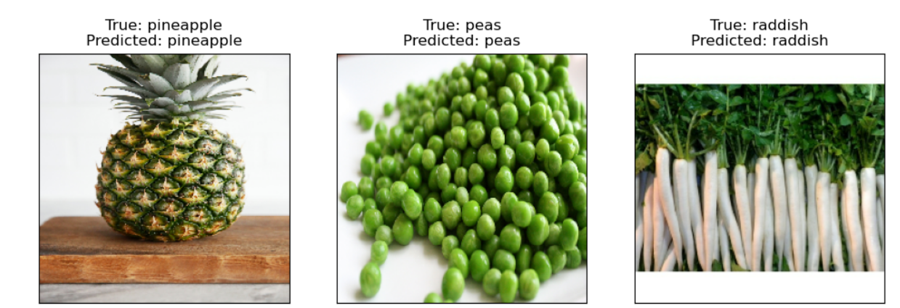
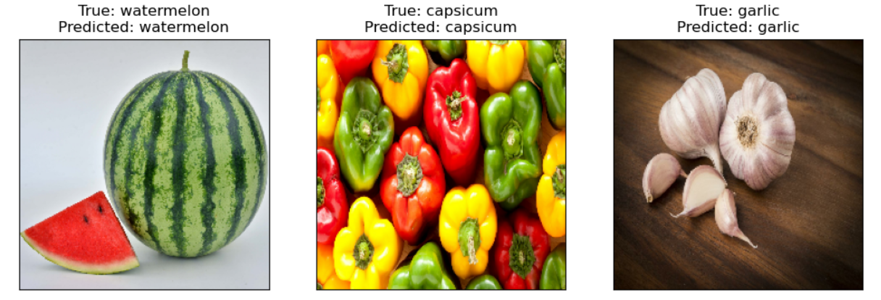
PREDICTED FRIUTS AND VEGETABLES

